Slide 1
Chinese Degrowth
Impact on the world

Slide 2
Chinese economy in general
The Chinese economy has been growing very rapidly, and is now one of the biggest economies in the world.
In terms of population it has about one-fifth of the world’s population. Which in turn has given a benefit of cheap labors and a lesser opportunity cost of labor. This provides a vast benefit against automisation in many fields.
Many countries rely on many Chinese products as well as it has also disturbed the domestic market for many.

Slide 3
Degrowth
Degrowth is a political, economic, and social movement based on ecological economics, anti consumerist and anti-capitalist ideas. It is also considered an essential economic strategy responding to the limits-to-growth dilemma. Degrowth thinkers and activists advocate for the downscaling of production and consumption—the contraction of economies—arguing that overconsumption lies at the root of long term environmental issues and social inequalities. Key to the concept of degrowth is that reducing consumption does not require individual martyring or a decrease in well-being. Rather, 'degrowthists' aim to maximize happiness and well-being through non-consumptive means—sharing work, consuming less, while devoting more time to art, music, family, culture and community.

Slide 4
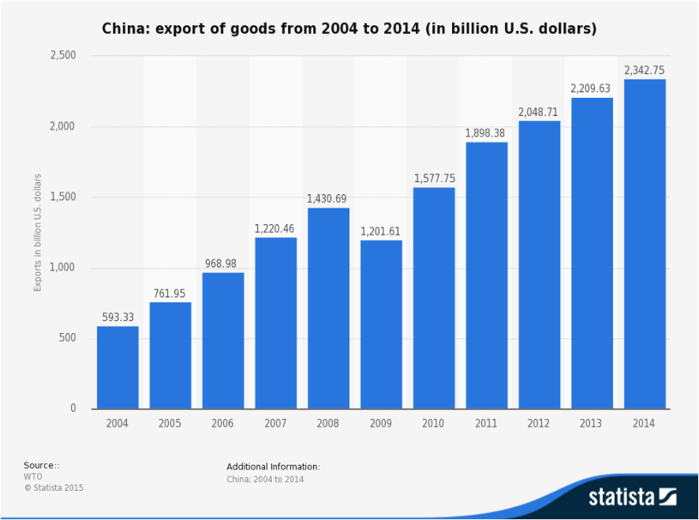
China export data

Slide 5
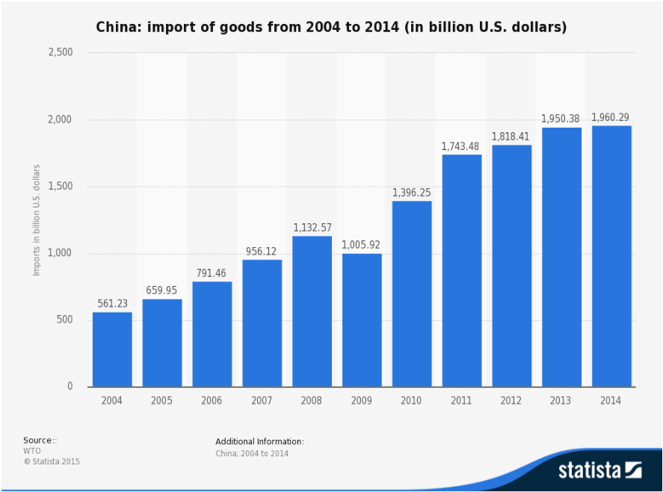
China import data

Slide 6
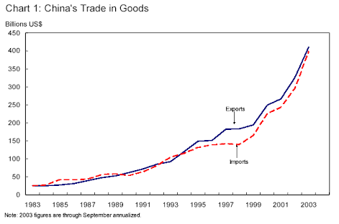
Balance of payment till 2003

Slide 7
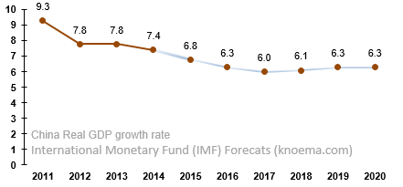
GDP growth rate of China
Since 2010, the economic growth rate of China started to decline gradually. The GDP growth rate dropped from 9.3% in 2011 to 7.4% in 2014 .According to the International Monetary Fund (IMF) GDP growth forecast numbers, the downtrend in the growth rate will continue until 2018 after which the gradual recovery will follow.

Slide 8
OECD Report of slow down of Chinese economy
According to The Organization for Economic Cooperation and Development (OECD), a 2% point decline in Chinese domestic demand growth will cause a decrease in the US GDP growth rate by about 0.3% points in 2015 and 2016. The graph below shows that the slowdown will have a wide coverage, being highest in the Japanese economy which is closely related to the Chinese economy. Overall, the world economic growth will decline by 0.5–0.6% points.

Slide 9
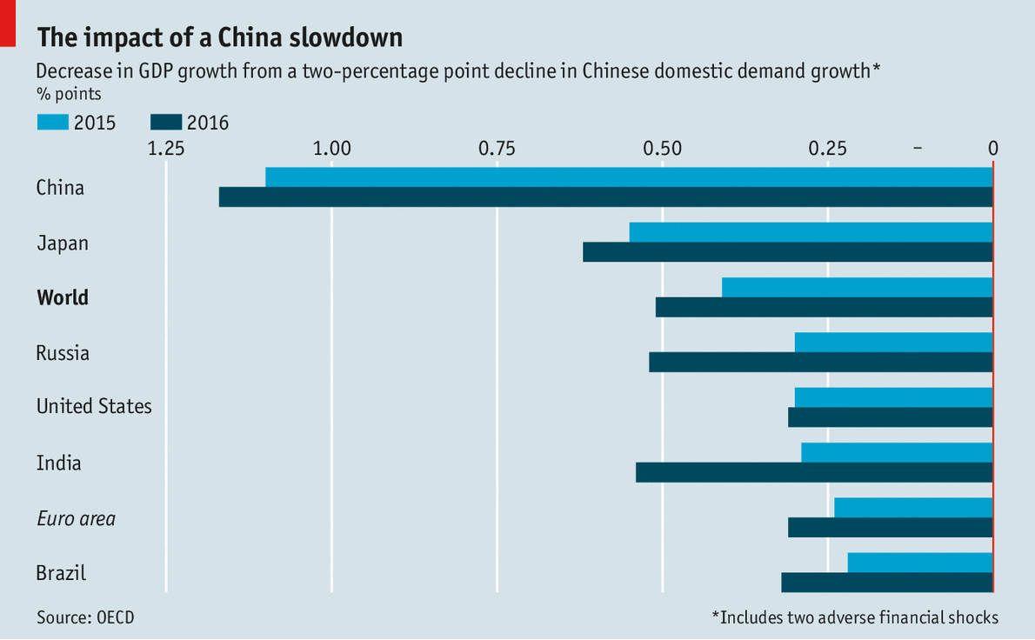

Slide 10
Causes of Degrowth
Population
Shortage of power
Growing income inequality
Property boom
Unemployment
Undervaluation of Yuan
Overheating economy
Huge balance of economy surplus
degradable plastic market in china
A shift from trade of goods to trade of services

Slide 11
Impacts
The slow down in china has hit the world trade in general as patients who breathed in Chinese sneeze pass the germs onto other countries which then further pass it further down the line.
Fluctuations in capital markets, Interest rates, currencies and commodities are blamed on economic development in china
China’s slowing economy has negative effect on Asian economies(except Philippines) and those in Asia-Pacific(except India)

Slide 12
The US isn’t worried, the Eurozone is keenly watching the situation, and the other countries in the Asia-Pacific region, such as Japan, South Korea and Australia, are preparing to cope with likely severe impacts. For many African countries, exports to China are critical for sustained growth.

Slide 13
Australia
More than 30 percent of Australia’s exports are consumed by China. These exports include iron ore, coal, coal briquettes, copper, nickel, cereals, meat, wool, fur skins and hides
Export prices of some of its commodities are already being impacted by the slowdown.
Australia has recently entered into trade treaties with Japan and South Korea in an effort to overcome the impact of China’s slowdown

Slide 14
Japan and South Korea
Japan exports primarily electronic equipment, machinery, pumps, medical electronic equipment, automobiles, chemicals, plastics, copper, steel and ferrous products to China. This amounts to 8 percent of China’s imports and 20 percent of Japan’s overall exports.
South Korea’s dependence on China amounts to approximately 29 percent of its export trade. Exports comprise electronic goods and components, medical and surgical equipment, mechanical equipment, engines, chemicals, oils, auto parts and products, steel products and copper.

Slide 15
African Distress
The Chinese slowdown has the potential to damage the economies of Sub-Saharan countries which are showing signs of growth on the strength of demand for minerals and other natural resources, predominantly from China.
The ores of iron and copper are not as encouraging as industrial production is not growing at the previous rate.

Slide 16
Brazil
Brazil exports iron ore, copper, slag, wood pulp, sugar, rawhides, animal fats, meats. Industrial-input materials such as copper and iron ores are likely to face a downturn. Exports to China constitute 19 percent of its total.

Slide 17
Southeast Asia
For Thailand, exports consist of machinery, electronics, fruits, nuts, vegetables, wood, rubber. Even though these account for only 2 percent of China’s imports, they are critical for Thailand’s economy. Similarly, Indonesia exports primarily oil, minerals, rubber, wood, pulp, animal fats and electronic equipment, and may be moderately affected by the downturn.
Malaysia’s exports to China account for 15 percent of its export economy. They consist mainly of oil, electronic-integrated circuits and palm oil. Singapore’s exports make up 1.5 percent of Chinese imports, and the country has a diversified portfolio.

Slide 18
Other Regions
The US, Canada, the UK and France export aircraft, space equipment, machinery, electronic equipment and vehicles to China. US exports to China constitute a significant 9 percent of its export trade and 8 percent of total Chinese imports.
German exports account for 6.5 percent of total German export trade and 4.8 percent of overall Chinese imports. They comprise engines, machines, mechanical parts, pumps, automobiles, electronic and medical equipment, pharmaceuticals, spacecraft, copper, ferrous and steel products, chemicals.

Slide 19
The UK’s exports to China comprise spacecraft vehicles as well as mechanical, electronic and medical equipment
Chinese imports from Russia and Saudi Arabia comprise mainly oil, and they won’t be affected by the slowdown.

Slide 20
The Worst Sufferers
Countries such as Mauritania, Turkmenistan, Sierra Leone, Gambia, Mongolia, Mali, Solomon Islands, depend on China to purchase more than 50 percent of their exports. Their economies are much more vulnerable to the economic growth problems of China than most.

Slide 21
ADB Report
The report by Asian Development Bank(ADB) states that China’s growth has reduced from 7.3% in 2014 to 6.9% in 2015 and it expects that further it will be reduced to 6.8% in 2016 and and 6.6% in 2017.

Slide 22
Impact Of Chinese Stock Market Crash
Recently, the Chinese stock market has been very volatile, with sharp drops in prices since July 2015. On August 24th 2015, share prices fell 9% – one of the biggest single day falls. People fear this is the bursting of the Chinese stock market bubble which could have serious effects on the global economy.
Reduced exports:-
Global confidence:- Falls in Chinese stock markets, tend to be mirrored in other stock markets.
Rising dollar:-Another factor is that instability in China could cause investors to seek safe havens for their funds. Rather than hold Chinese and Asian shares, they may look to the US, where there appears to be greater stability. A rise in demand for US shares and bonds will push up the value of the dollar. This appreciation in the dollar will increase the price of US exports and lead to lower export sales.

Slide 23
Impact on India
As previously mentioned degrowth has not affected India till now ,in fact it has been an advantage for India as China was competitor of India in many ways. But again this advantage is not a long term advantage. Even India would catch the cold.
Recently the governor of RBI Raghuram Rajan also clearly mentioned that the degrowth of China is a temporary relief for India. It will gradually affect India in future.

Slide 24
Positive Impacts
A Chinese economic slowdown does not have only negative effects. One of the major factors why oil prices decreased from high levels was pessimistic expectations about the GDP growth rate in China, the biggest oil importer with about 7.4 million barrels per day as of April 2015. One of the biggest winners from low oil prices is the U.S. as the second biggest oil importer with about 7.2 million barrels as of April 2015. Lower oil prices positively affect trade balance deficit as the country’s cost to import oil decreases.

Slide 25
Thank You

